Slide 1
OUR NATURAL RESOURCES
By: Annette Miles

Slide 2
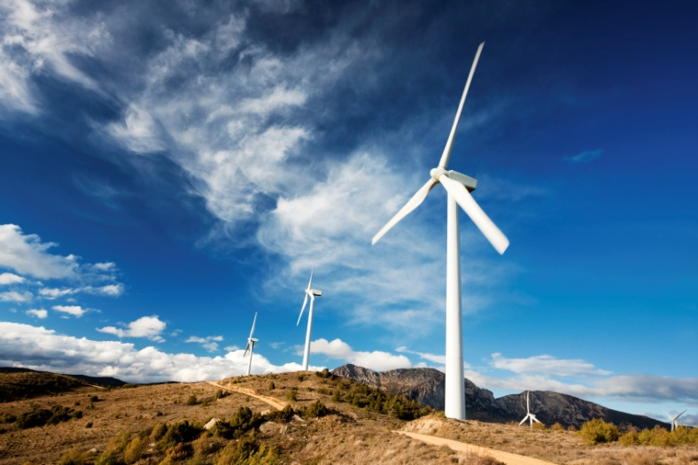
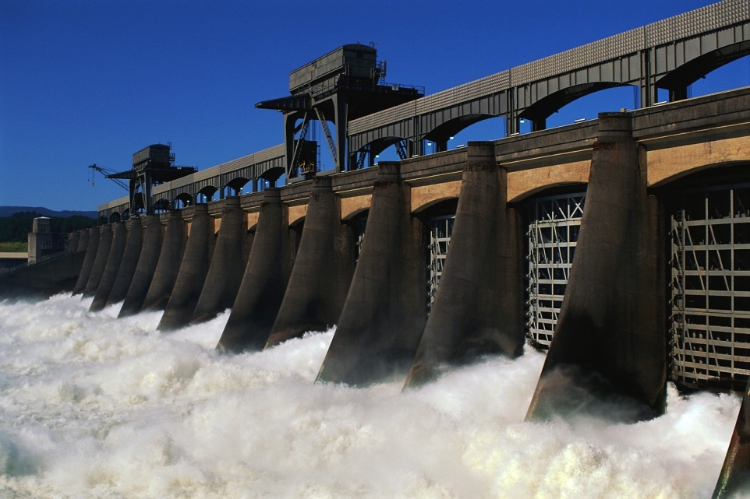

A _________ NATURAL RESOURCE is a natural resource that CAN be replaced within a person’s lifetime.
RENEWABLE

Slide 3
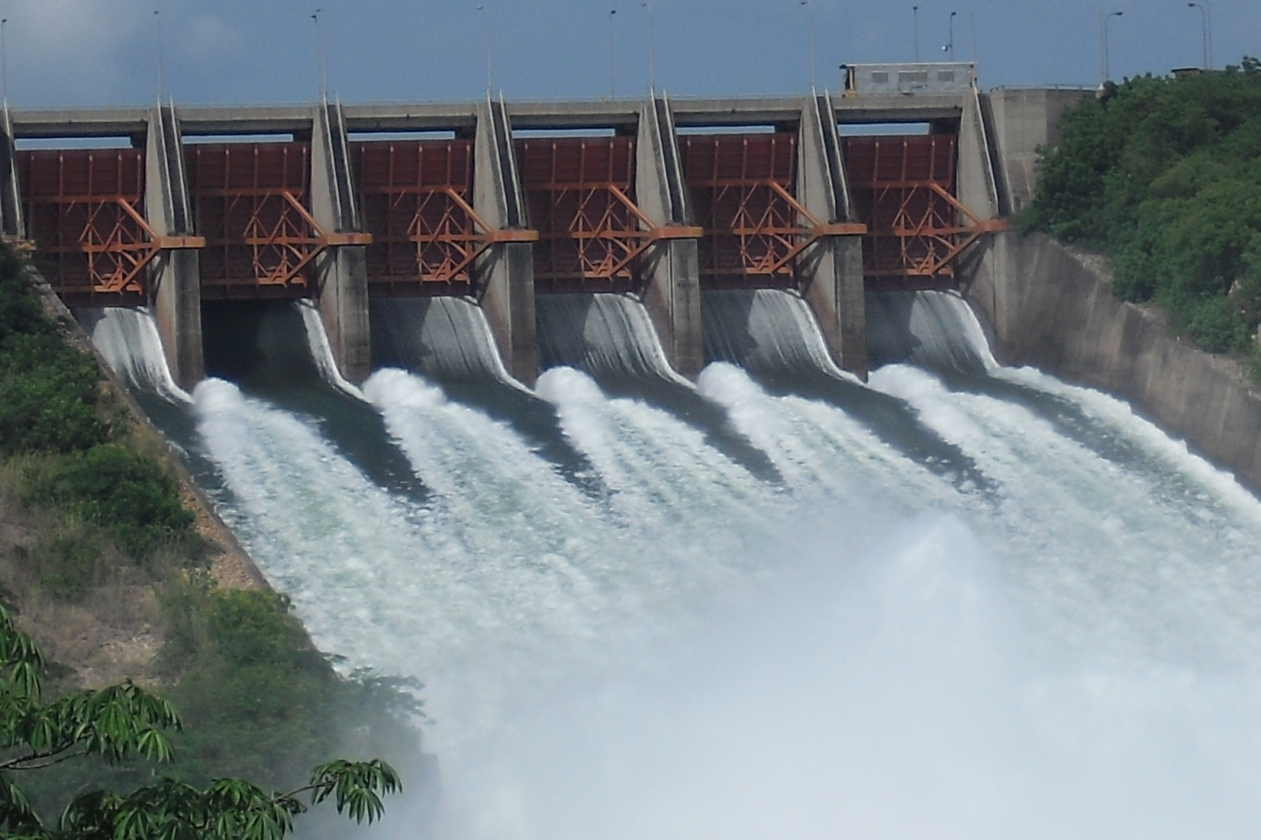
Here are some examples of renewable resources:
WATER
_______________

Slide 4
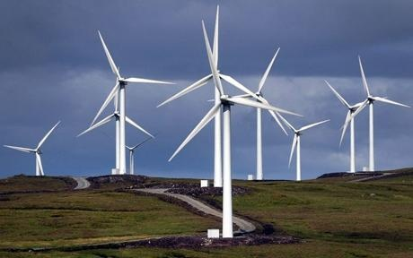
Here are some examples of renewable resources:
WIND
_______________

Slide 5

Here are some examples of renewable resources:
SOLAR
_______________

Slide 6
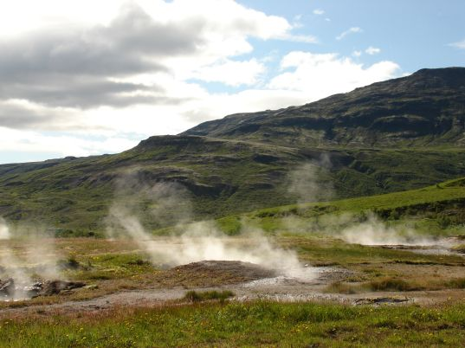
Here are some examples of renewable resources:
GEOTHERMAL
_____________________

Slide 7

There is the same amount of water, wind, and sunlight on Earth today as there was yesterday and will be tomorrow.

Slide 8
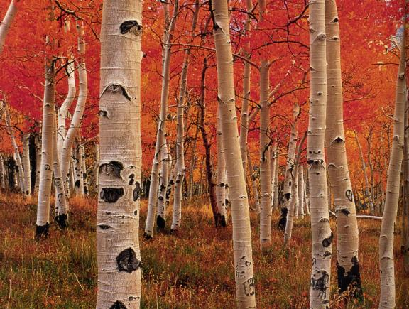
Here are some examples of other kinds of renewable resources:
Trees
(wood)

Slide 9
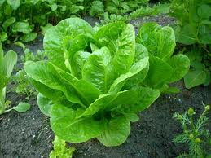
Here are some examples of other kinds of renewable resources:
Crops that we eat – like lettuce…

Slide 10
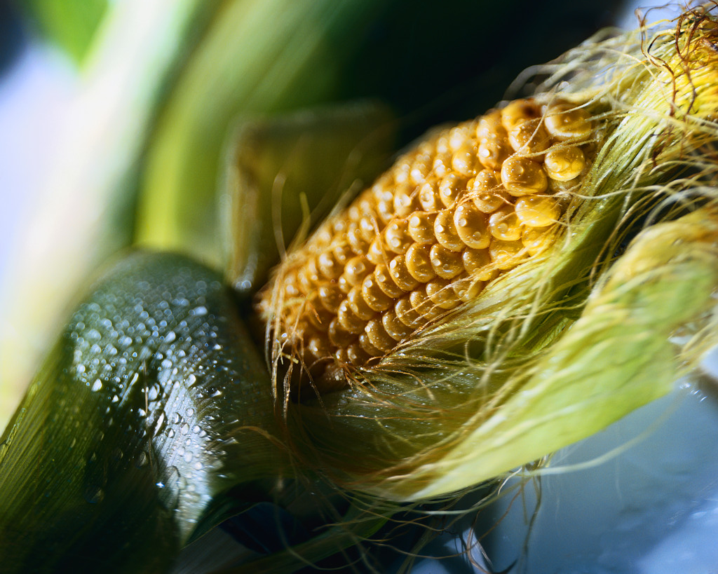
Here are some examples of other kinds of renewable resources:
….and corn.

Slide 11
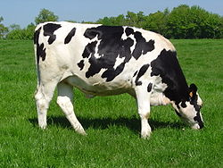
Here are some examples of other kinds of renewable resources:
Animals – that we use for food…

Slide 12
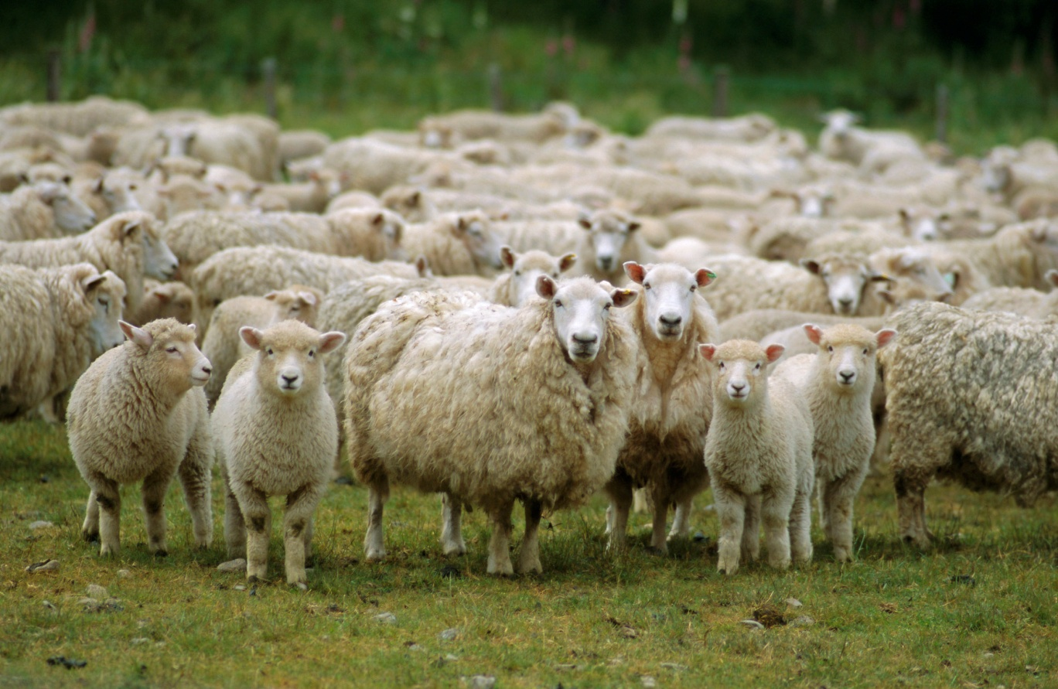
Here are some examples of other kinds of renewable resources:
…or for other resources such as wool.

Slide 13
A ________________NATURAL RESOURCE is a natural resource that will be used up some day.
NONRENEWABLE
The main nonrenewable resources that we use are ___________.
These are fuels that were formed over many years from the remains of once living organisms.
fossil fuels

Slide 14
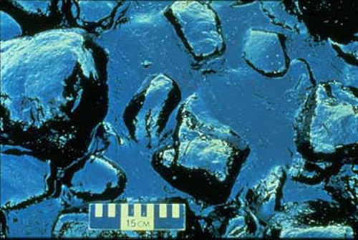
Here are some examples of nonrenewable resources:
___
OIL
THIS IS A FOSSIL FUEL

Slide 15

Here are some examples of nonrenewable resources:
___
coal
THIS IS A FOSSIL FUEL

Slide 16
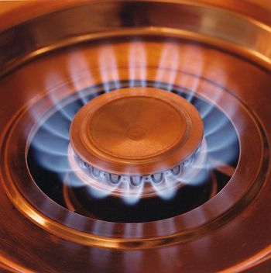
Here are some examples of nonrenewable resources:
___________
Natural
Gas
THIS IS A FOSSIL FUEL

Slide 17
Where did the energy come from that these fossil fuels store as chemical energy?
THE SUN !
To release the chemical energy, we ______ the fossil fuels.
burn

Slide 18
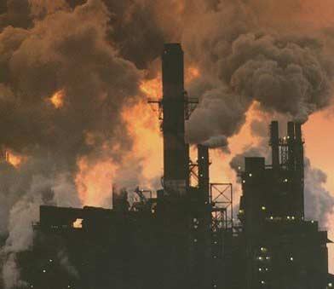
A problem: The burning of these fossil fuels creates _______________.
air pollution

Slide 19

Here is another example of a nonrenewable resource:
Metals

Slide 20
Once these resources are gone we cannot replace them!

Slide 21
Look at the following pictures and guess if they are a renewable resource or a nonrenewable resource.

Slide 22
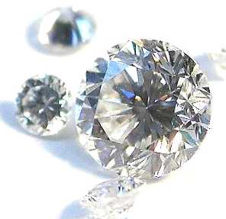
Diamonds !
NON – RENEWABLE RESOURCE

Slide 23
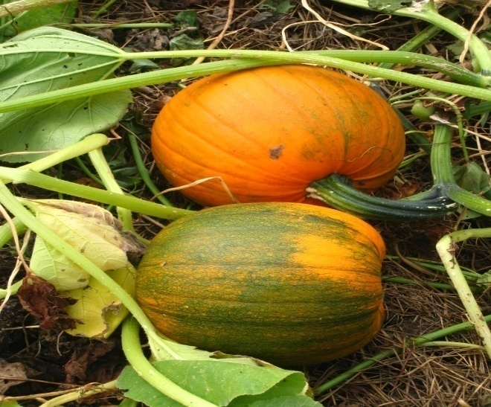
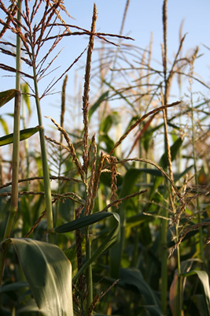
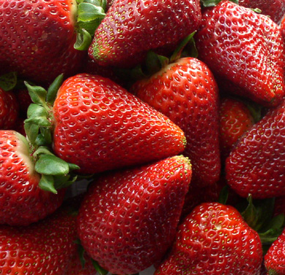
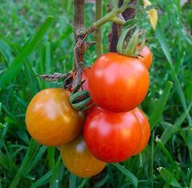
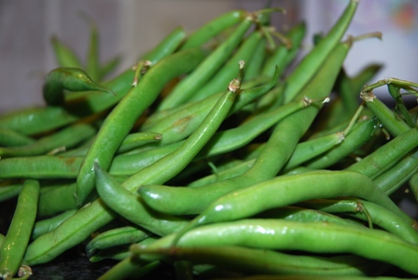
Food Plants !
RENEWABLE RESOURCE

Slide 24
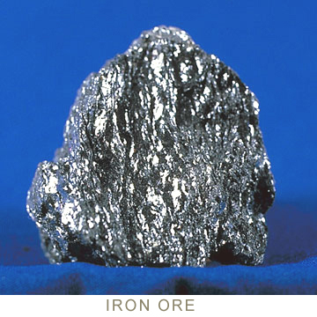
Iron Ore !
NON – RENEWABLE RESOURCE

Slide 25
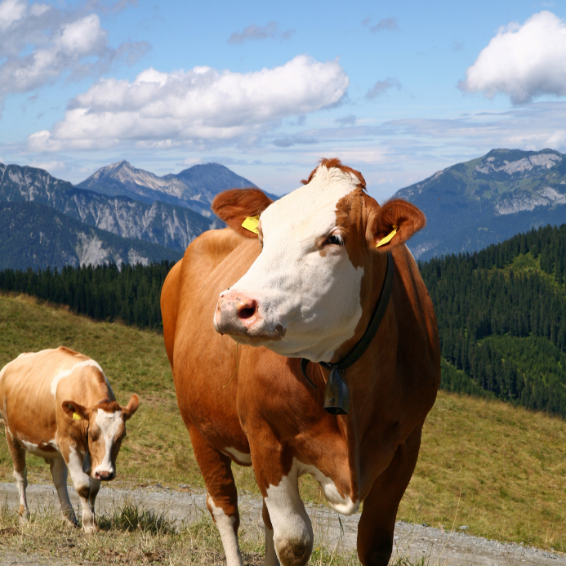
Animals !
RENEWABLE RESOURCE

Slide 26

Wind !
RENEWABLE RESOURCE

Slide 27
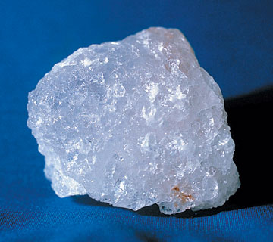
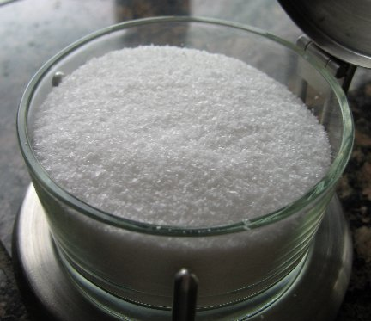
Salt!
NON – RENEWABLE RESOURCE

Slide 28
Coal !
NON – RENEWABLE RESOURCE

Slide 29
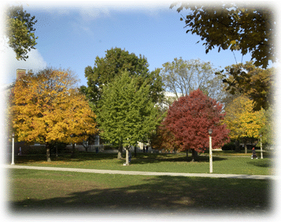
Trees!
RENEWABLE RESOURCE

Slide 30
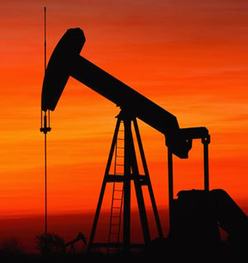
Oil !
NON – RENEWABLE RESOURCE

Slide 31

We need to conserve and take care of all of our natural resources!

Slide 32
RESOURCES
http://www.google.com/imgres?q=biomass&hl=en&sa=X&qscrl=1&rlz=1T4ADSA_enUS387US388&biw=1600&bih=741&tbm=isch&prmd=imvnsu&tbnid=EXz6yQ4s3pA6CM:&imgrefurl=http://library.thinkquest.org/06aug/01335/biomass.htm&docid=UVOY50hYzoxOYM&imgurl=http://library.thinkquest.org/06aug/01335/images/BIOMASSTYPES1.gif&w=288&h=362&ei=L7R8UKGHDMvo2gXkxYGYAg&zoom=1&iact=hc&vpx=531&vpy=232&dur=18144&hovh=252&hovw=200&tx=121&ty=147&sig=114008313194622623840&page=1&tbnh=130&tbnw=103&start=0&ndsp=30&ved=1t:429,r:10,s:0,i:167
http://www.google.com/imgres?q=trees&hl=en&sa=X&qscrl=1&rlz=1T4ADSA_enUS387US388&biw=1600&bih=741&tbm=isch&prmd=imvns&tbnid=VUal8BxGdL-ZTM:&imgrefurl=http://www.dailygalaxy.com/my_weblog/2007/10/scientists-bio-.html&docid=hBV6DmVTwrhY8M&imgurl=http://www.dailygalaxy.com/photos/uncategorized/2007/10/17/trees_2.jpg&w=576&h=435&ei=n7V8UKarF8ew2gWqs4HwDQ&zoom=1&iact=rc&dur=430&sig=114008313194622623840&page=1&tbnh=136&tbnw=169&start=0&ndsp=32&ved=1t:429,r:9,s:0,i:177&tx=135&ty=73
http://upload.wikimedia.org/wikipedia/commons/a/ae/Akosombo_Dam_is_spilling_water,_Ghana.JPG
http://i.telegraph.co.uk/multimedia/archive/01688/wind-farm_1688864c.jpg
http://www.modernfaqs.com/wp-content/uploads/2012/09/solar-panels.jpg
http://yoganurse.com/wp-content/uploads/2012/08/making-sense-of-time.jpg
http://www.google.com/search?q=lettuce&hl=en&qscrl=1&rlz=1T4ADSA_enUS387US388&prmd=imvnse&source=lnms&tbm=isch&sa=X&ei=Xbh8UJn6Najc2QWZpYDgCA&ved=0CAcQ_AUoAQ&biw=784&bih=733

Slide 33
http://upload.wikimedia.org/wikipedia/commons/thumb/7/7d/Holstein_heifer.jpg/250px-Holstein_heifer.jpg
http://img.timeinc.net/time/2009/50_asian_experiences/50_asian_experiences_sheep.jpg
http://www.google.com/imgres?q=metals&hl=en&sa=X&qscrl=1&rlz=1T4ADSA_enUS387US388&biw=784&bih=733&tbm=isch&prmd=imvnsuz&tbnid=SRep1L5vppv5NM:&imgrefurl=http://www.chaparraltech.net/sintered_metals.html&docid=31m7hAhmQ7UuDM&imgurl=http://www.chaparraltech.net/images/sintered_metals_image.jpg&w=600&h=337&ei=07p8UL3cNcjk2QXN4YGQDQ&zoom=1&iact=hc&vpx=441&vpy=194&dur=37&hovh=168&hovw=300&tx=160&ty=64&sig=114008313194622623840&page=1&tbnh=130&tbnw=246&start=0&ndsp=13&ved=1t:429,r:2,s:0,i:143
http://www.google.com/imgres?q=coal&hl=en&sa=X&qscrl=1&rlz=1T4ADSA_enUS387US388&biw=784&bih=733&tbm=isch&prmd=imvns&tbnid=6I-UFFS31jP_HM:&imgrefurl=http://netrightdaily.com/2012/03/time-to-end-the-war-on-coal/&docid=RxXDrs7QmePSiM&imgurl=http://netrightdaily.com/wp-content/uploads/2010/09/Coal.jpg&w=875&h=582&ei=F7p8UKnLM8eg2AWqr4GQBg&zoom=1&iact=rc&dur=316&sig=114008313194622623840&page=1&tbnh=130&tbnw=209&start=0&ndsp=13&ved=1t:429,r:3,s:0,i:146&tx=152&ty=46
http://www.google.com/imgres?q=natural+gas&hl=en&sa=X&qscrl=1&rlz=1T4ADSA_enUS387US388&biw=784&bih=733&tbm=isch&prmd=imvnslz&tbnid=twUuBlWVihpHjM:&imgrefurl=http://www.marcgunther.com/2010/11/28/natural-gas-friend-or-foe-of-sustainability/&docid=ZUKFfmu3p-AtaM&imgurl=http://www.marcgunther.com/wp-content/uploads/natural-gas_4.jpg&w=350&h=352&ei=OLp8UKDWKMPs2QXaiIEQ&zoom=1&iact=rc&dur=759&sig=114008313194622623840&page=1&tbnh=138&tbnw=137&start=0&ndsp=15&ved=1t:429,r:0,s:0,i:150&tx=88&ty=94
http://www.google.com/imgres?q=air+pollution&hl=en&sa=X&qscrl=1&rlz=1T4ADSA_enUS387US388&biw=784&bih=733&tbm=isch&prmd=imvnsb&tbnid=pc4Vodnnzh2mlM:&imgrefurl=http://deepgreenresistance.org/fieldguide/air-pollution/&docid=A_x9UsvF2PtskM&imgurl=http://deepgreenresistance.org/wp-content/uploads/2012/05/Air-Pollution.jpg&w=392&h=339&ei=Zbp8UL6yMfO42gXykoDoAw&zoom=1&iact=hc&vpx=500&vpy=78&dur=754&hovh=209&hovw=241&tx=182&ty=156&sig=114008313194622623840&page=1&tbnh=143&tbnw=211&start=0&ndsp=13&ved=1t:429,r:5,s:0,i:152

Slide 34
http://www.google.com/imgres?q=diamonds&hl=en&sa=X&qscrl=1&rlz=1T4ADSA_enUS387US388&biw=784&bih=733&tbm=isch&prmd=imvns&tbnid=5xEtrAYwaGGl7M:&imgrefurl=http://www.goodmanandsons.com/diamonds/diamond-request.html&docid=TvRMHZcdXpLKZM&imgurl=http://www.goodmanandsons.com/skin/frontend/default/modern/images/nocolordiamond.jpg&w=296&h=287&ei=HLt8UJ31EPG42QXwiYCIAg&zoom=1&iact=rc&dur=324&sig=114008313194622623840&page=2&tbnh=147&tbnw=152&start=15&ndsp=19&ved=1t:429,r:18,s:0,i:204&tx=78&ty=126
http://www.google.com/imgres?imgurl=http://www.mii.org/Minerals/Minpics1/Hematite2.jpg&imgrefurl=http://www.mii.org/minerals/photoiron.html&h=335&w=360&sz=103&tbnid=qsEinDqKXKnvfM:&tbnh=90&tbnw=97&prev=/search%3Fq%3Diron%2Bore%26tbm%3Disch%26tbo%3Du&zoom=1&q=iron+ore&usg=__3-M5fAGlcMN-1lbNh4m3zwL7qjg=&docid=COQHZehhHC76zM&hl=en&sa=X&ei=XLx8UMSbMIjs2QWK3YHoCQ&ved=0CDQQ9QEwAg&dur=377
http://free-extras.com/images/bunny_and_puppy-276.htm
http://www.google.com/imgres?q=salt&hl=en&sa=X&qscrl=1&rlz=1T4ADSA_enUS387US388&biw=784&bih=733&tbm=isch&prmd=imvnse&tbnid=OjG_ar1fohObFM:&imgrefurl=http://www.mii.org/minerals/photosalt.html&docid=Mn67k-YYxeirHM&imgurl=http://www.mii.org/Minerals/Minpics1/Rock%252520Salt.jpg&w=360&h=320&ei=37x8UPmTOc6u2AXWyIDYDQ&zoom=1&iact=rc&dur=1&sig=114008313194622623840&page=1&tbnh=141&tbnw=154&start=0&ndsp=16&ved=1t:429,r:6,s:0,i:155&tx=91&ty=101
http://1.bp.blogspot.com/--WHnB3Y1Nis/UAEasnsIPgI/AAAAAAAAAO0/CquKv8auODQ/s1600/conserve.jpg
http://www.google.com/imgres?q=geothermal&hl=en&sa=X&qscrl=1&rlz=1T4ADSA_enUS387US388&biw=1600&bih=741&tbm=isch&prmd=imvnsl&tbnid=xgZxKYXuAs4xDM:&imgrefurl=http://inhabitat.com/iceland-may-tap-liquid-magma-as-new-geothermal-energy-source/&docid=bT4MNn3PUkNPhM&imgurl=http://assets.inhabitat.com/images/steamystuff2.jpg&w=537&h=402&ei=WOl9UOO8OcXXqgGgTA&zoom=1&iact=hc&vpx=943&vpy=377&dur=5601&hovh=194&hovw=260&tx=129&ty=92&sig=114008313194622623840&page=2&tbnh=139&tbnw=168&start=27&ndsp=35&ved=1t:429,r:11,s:20,i:234

